Slide 1
Image Classification and Object detection of Cassava and Banana plants
By Gloria Ainebyona
Student No: 2100702283
Registration No: 2021/HD05/2283U

Slide 2
Task 1: Image Classification
Image classification is a field in computer vision that deals with categorising and labelling groups of pixels with in an image using a collection of predefined categories that an algorithm has been trained on.
This involves;
Choosing a dataset
Preparing the dataset for training
Normalising the data
Splitting data into training and testing

Slide 3
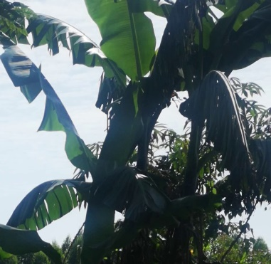
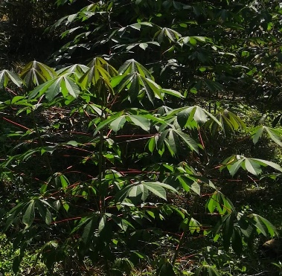
Image classification
Classification based on contextual information with in images.
Steps taken in this task
Image cropping; This was done with the use of Microsoft Office Picture Manager.

Slide 4
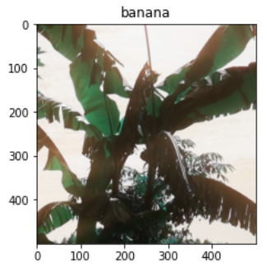
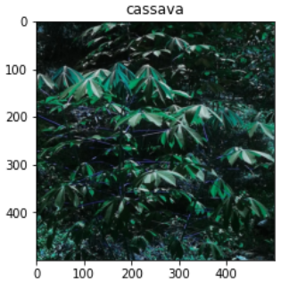
Image classification..
Steps taken..
Image resizing; I resized all the images to 500*500 for uniformity.

Slide 5
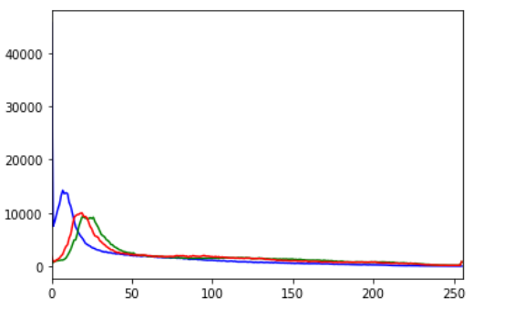
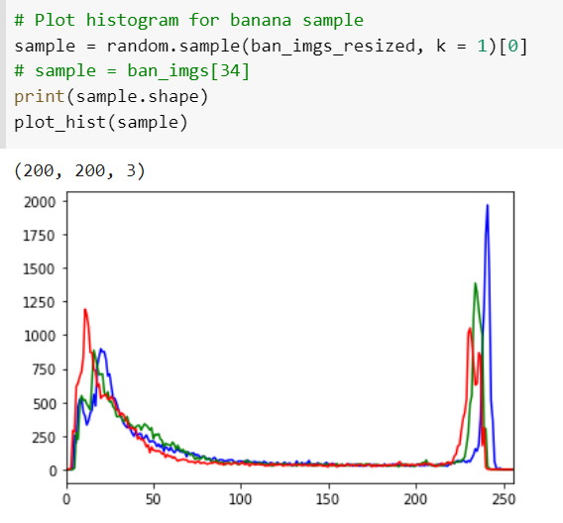
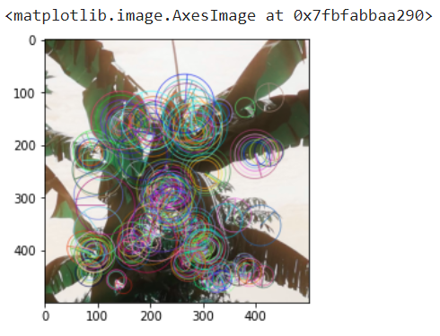
Image classification..
Steps taken..
Feature detection and drawing key points from the cropped images.
Colour histograms, ORB, SIFT were considered.

Slide 6
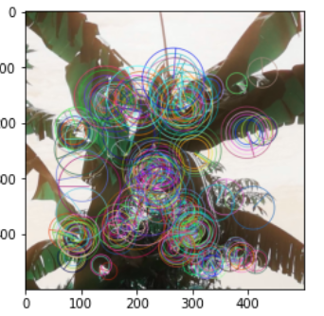
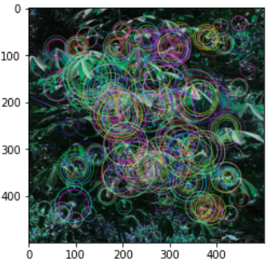
Image classification..
Key points on Banana and cassava images.
These help to show the unique feature distinction in the images.

Slide 7
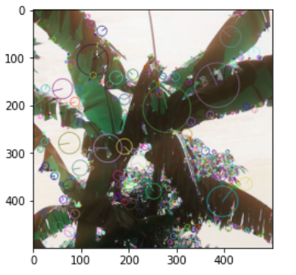
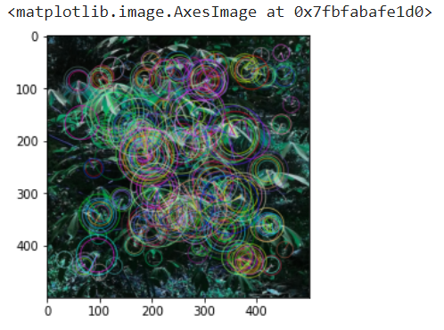
Image classification..
SIFT key points

Slide 8
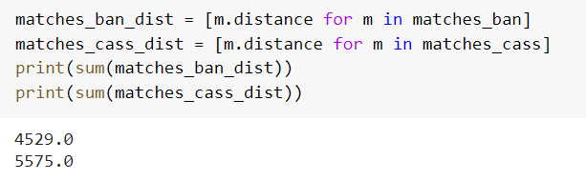
Image classification..
Steps taken..
Comparing descriptors of banana and cassava images.
Use the Bf matcher object match features of the different images.
From this, I computed the sum of the returned matched distances.

Slide 9
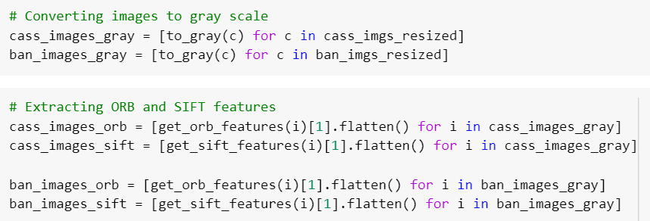
Image classification..
Steps taken..
Feature extraction
I first converted the resized images to gray scale.
Extracted features using Oriented FAST and rotated BRIEF (ORB) and Scale-Invariant Feature Transform (SIFT).

Slide 10
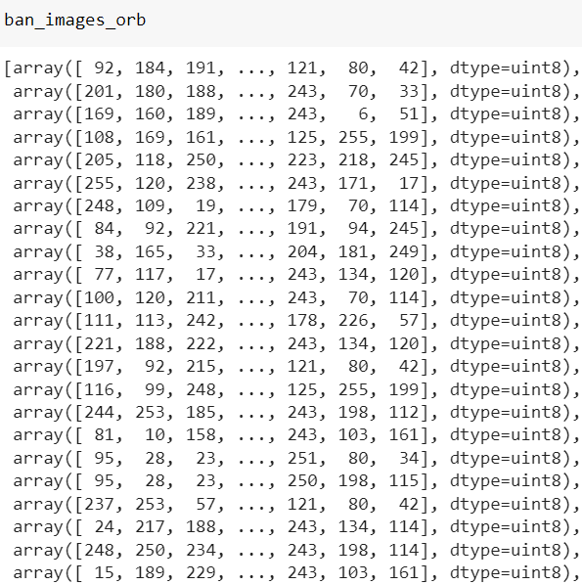
Image classification..
Extracted ORB banana features

Slide 11
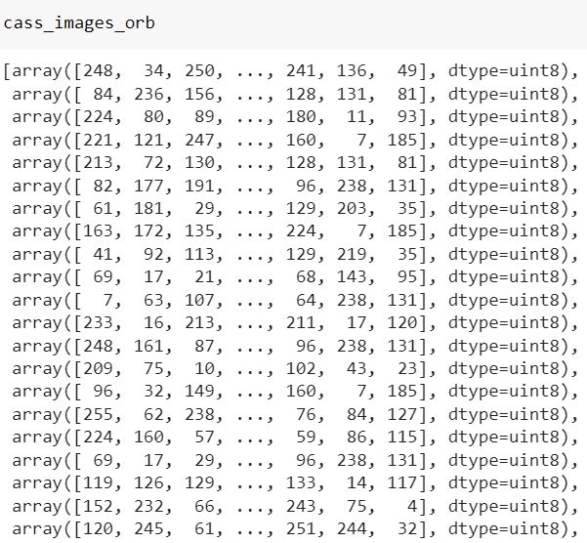
Image classification..
Extracted ORB cassava features

Slide 12
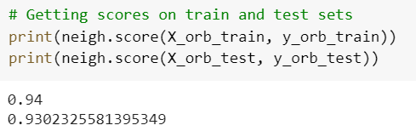
KNN Algorithm scores
I used K-Nearest Neighbour (KNN) algorithm for classification of the extracted features. I mainly used the ORB extracted features for classification because ORB executes faster compared to SIFT.
Train score =0.94 and test score = 0.93

Slide 13
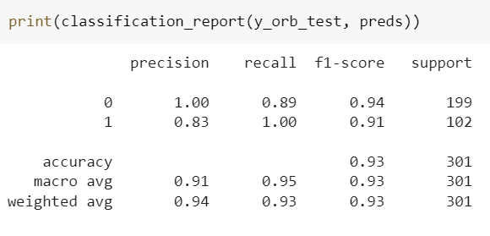
KNN Classification report
I also visualised results for the test data using the classification report where 0 denotes for cassava and 1 denotes for banana.

Slide 14
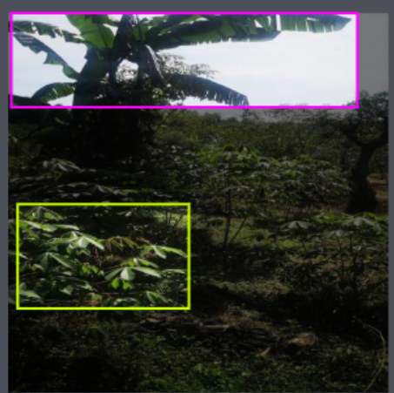
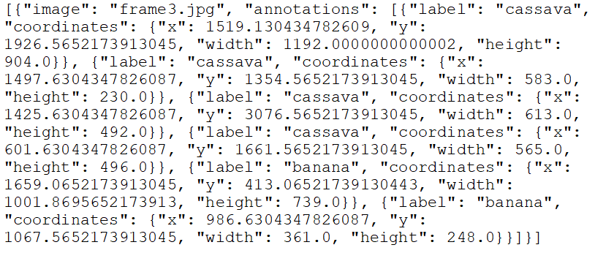
Task 2: Object detection
Object detection involves locating instances of objects with in an image.
Steps taken;
Image annotation
I used LabelImg to annotate all the images using bounding boxes which help to determine the target plant by extracting the x and y coordinates for the image’s borders.

Slide 15
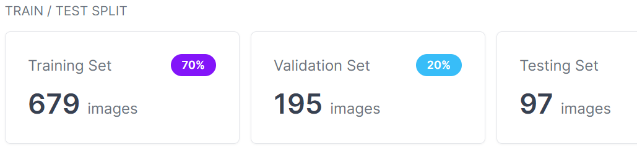
Object detection..
Steps taken..
Data splitting; I used the Roboflow tool to split the data into the training, testing and validation.

Slide 16
Object detection..
Steps taken..
Model training
With the help of roboflow tool, I used You Only Look Once (YOLOv5) model which was previously trained on coco dataset.
I considered a 416 image size, batch size of 32 and ran the model on 150 epochs.
Tensorboard was then used for visualisation of the results from the model training.

Slide 17
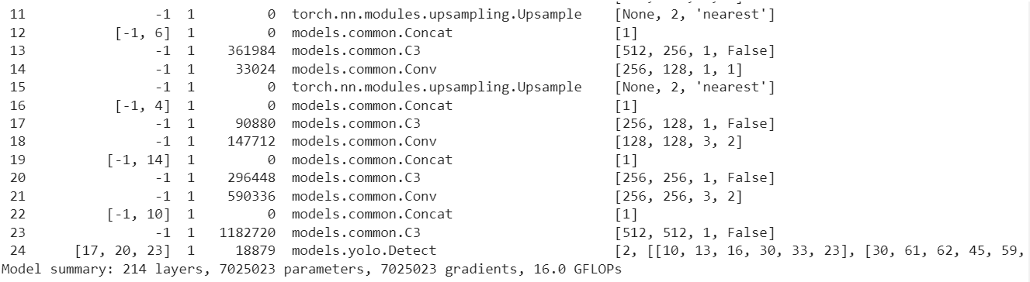
Object detection..
Model architecture
The model was trained on 214 layers with 7025023 parameters.

Slide 18
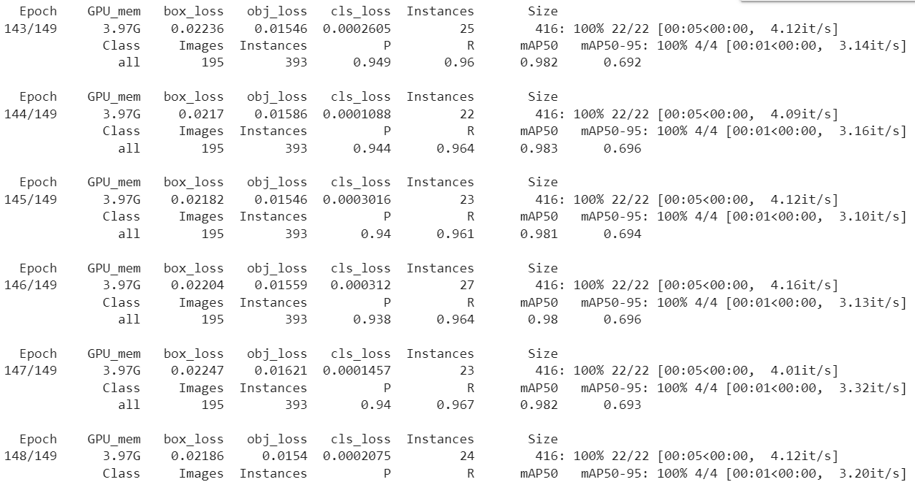
Object detection..
Sample of the epoch results during training

Slide 19
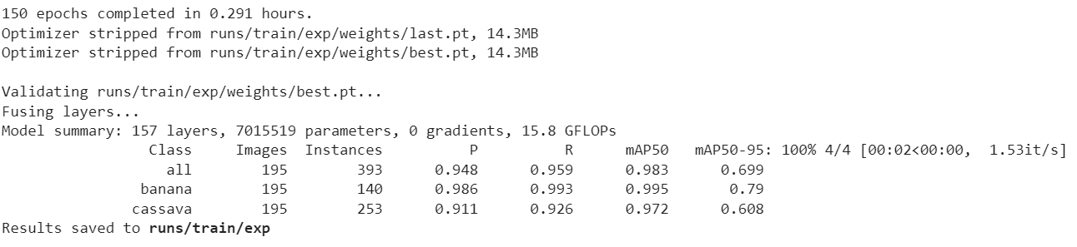
Object detection..
Model summary

Slide 20
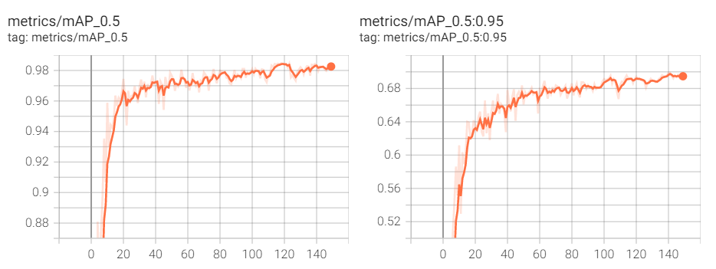
Object detection..
Visualisation of results from the tensor board
Mean Average Precision curves

Slide 21
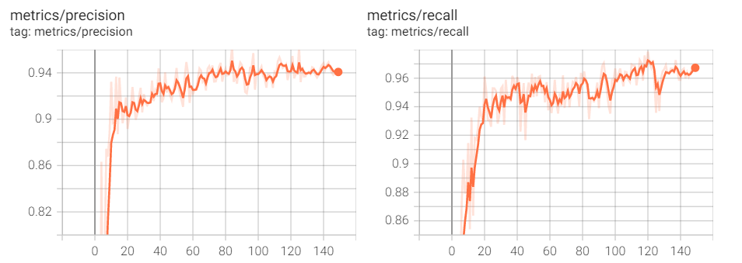
Object detection..
Visualisation of results from the tensor board..
Precision and Recall curves

Slide 22
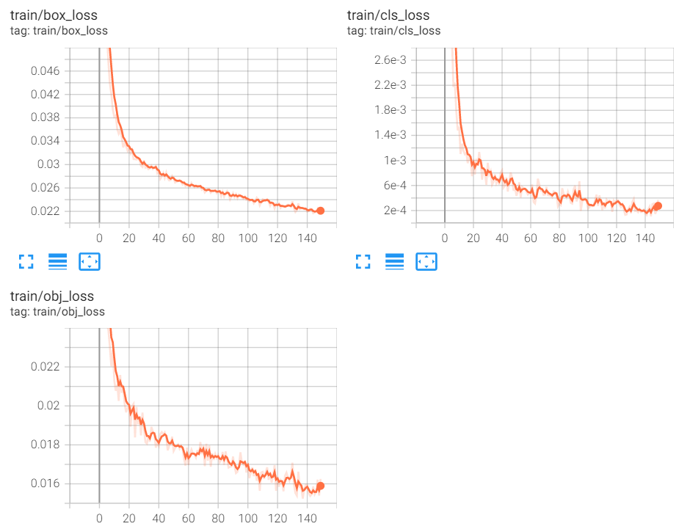
Object detection..
Visualisation of results from the tensor board..
Train box_loss, cls_loss and obj_loss curves

Slide 23
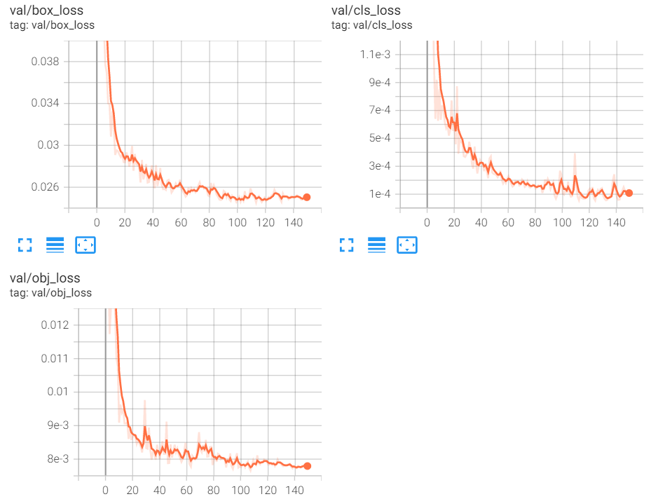
Object detection..
Visualisation of results from the tensor board..
Val box_loss, cls_loss and obj_loss curves

Slide 24
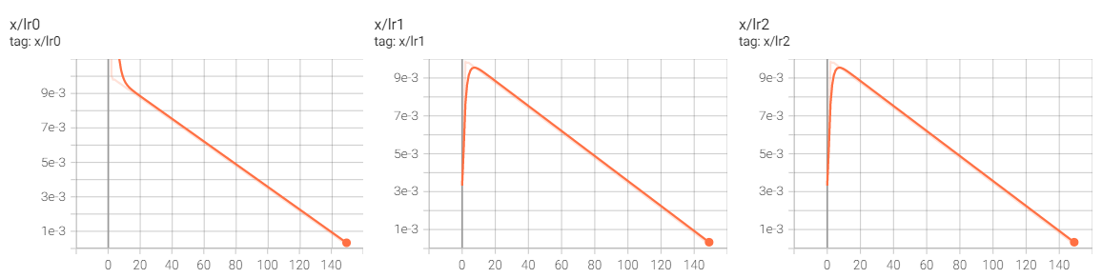
Object detection..
Visualisation of results from the tensor board..
Learning rate

Slide 25
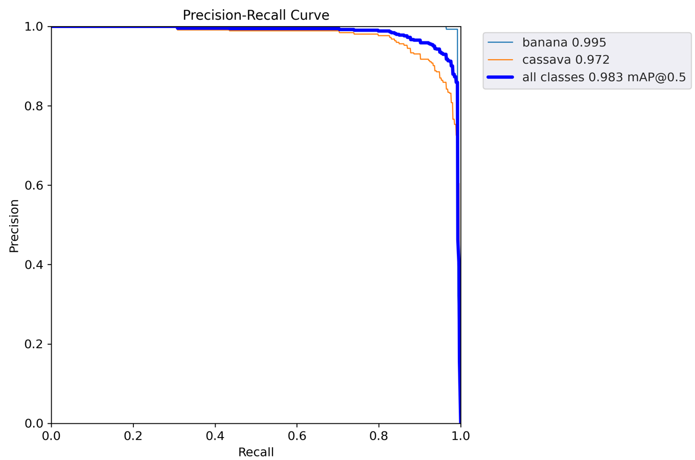
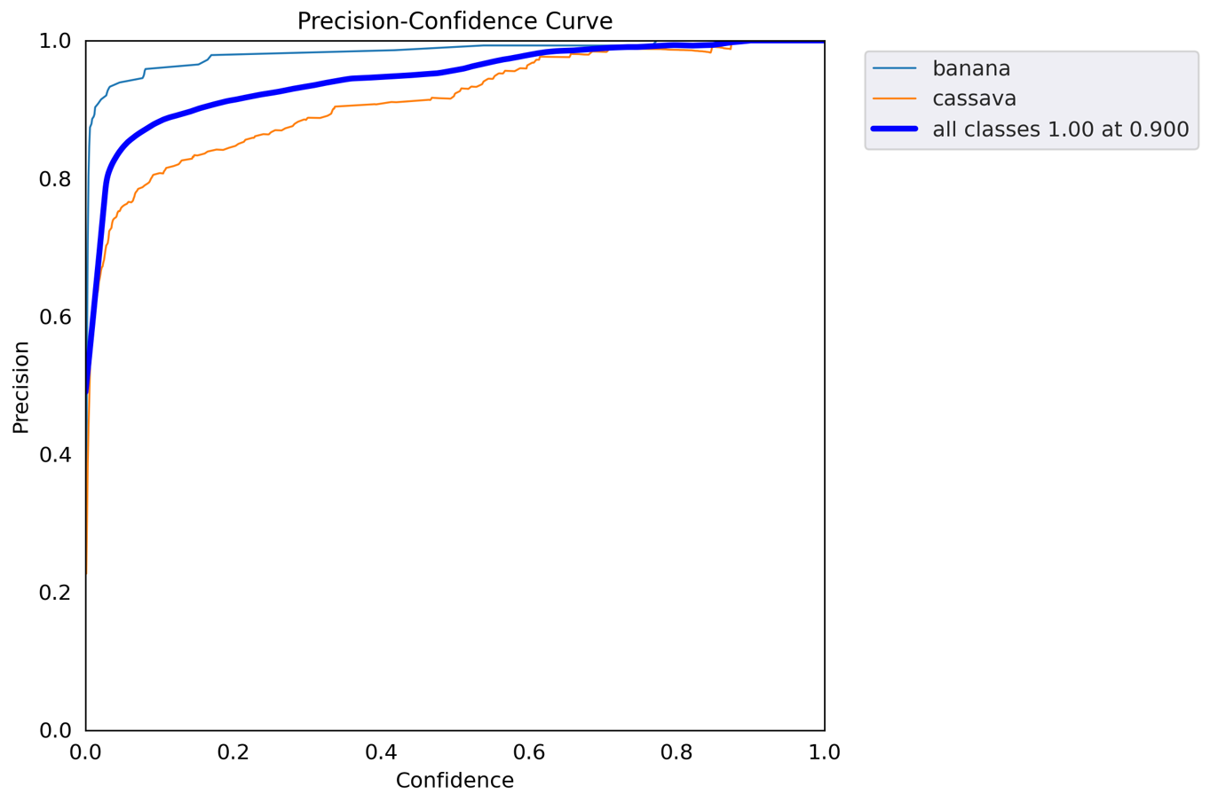
Object detection..
Precision-Recall curve
Precision Confidence curve

Slide 26
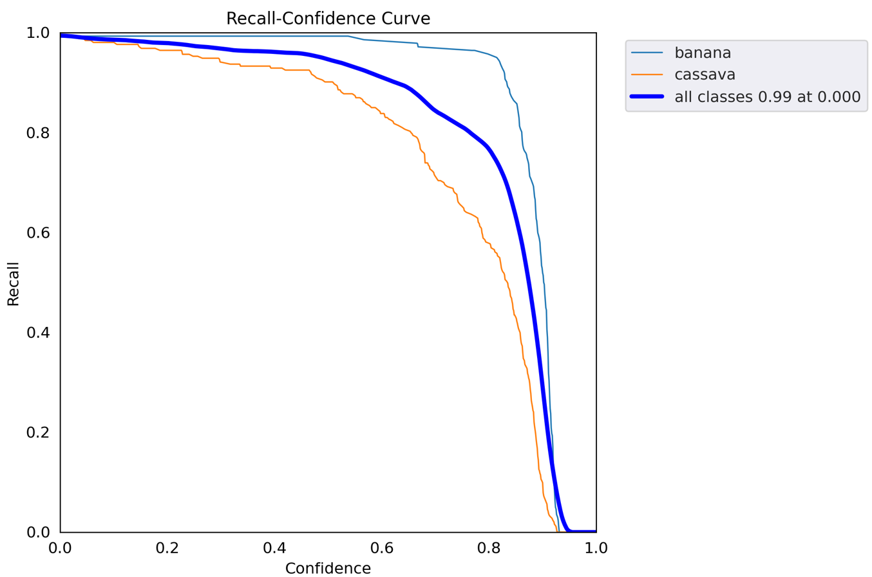
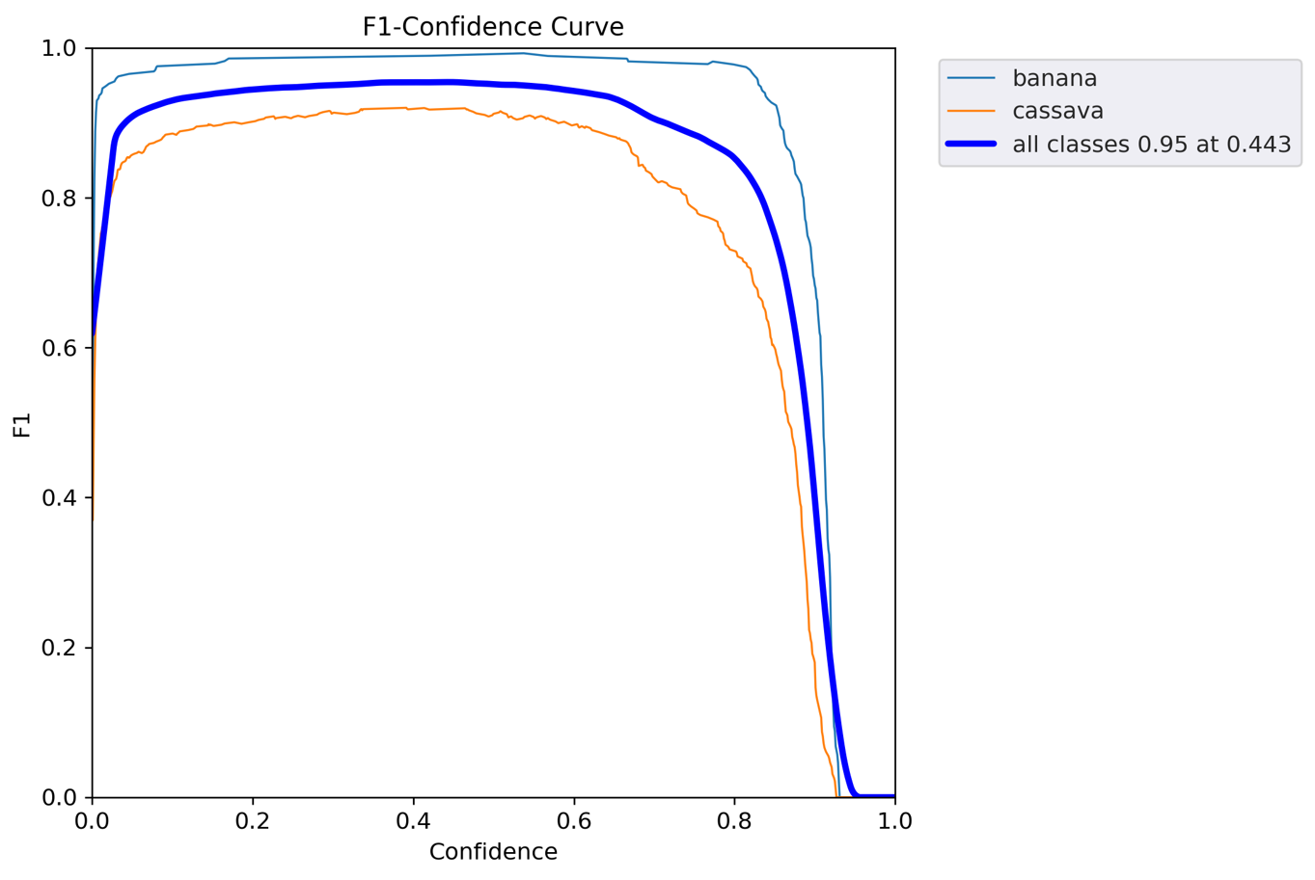
Object detection..
Recall-confidence curve
F-confidence curve

Slide 27
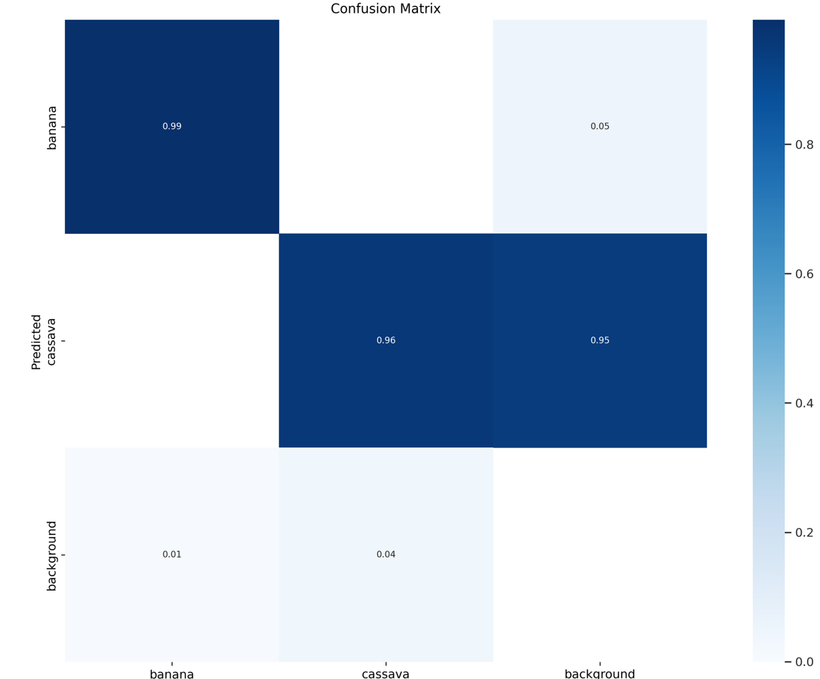
Object detection..

Slide 28
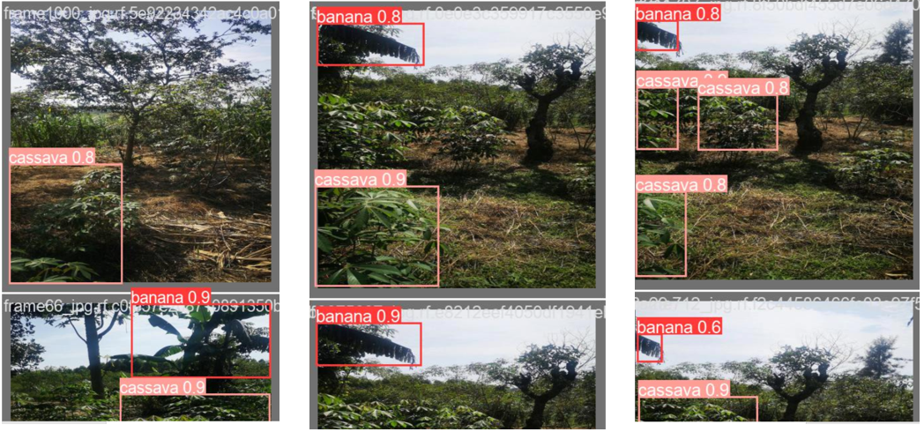
Object detection..
Prediction on unknown images
The model correctly predicted the plants as seen in the figure.

Slide 29
Observations from the results
YOLOv5 model preforms exceptionally good.
When tested with an image that has background clutter, it is still able to detect and identify the cassava and the banana plant.
YOLOv5 is simple, reliable and faster to use.
YOLOv5 is able to handle huge amount of data compared the KNN.

